Slide 1

RACSHAK

Slide 2
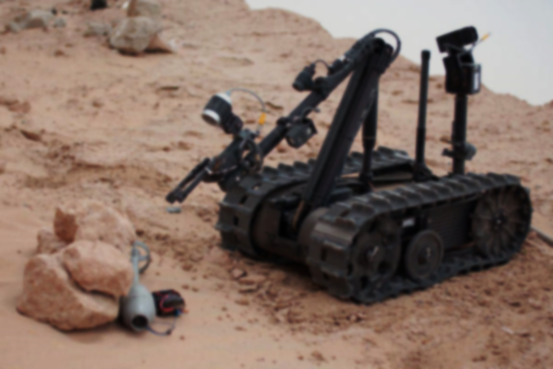
Road Autonomous Combat Surveillance High-tech Artificial Kart
(RACSHAK)

Slide 3
Final Year Project
Prathamesh Patil [16ET1111]
Pratik Pawar [16ET1013]
Anmol Talapady [16ET1120]
Abhishek Shinde [16ET1014]
Under the Guidance of:
Mrs. Poonam Gadge

Slide 4
INTRODUCTION
Military bots are autonomous robots or remote-controlled mobile robots designed for military operations which include transport of heavy machinery to forward base in extreme conditions to civilian search and rescue operations.
It also involves enemy reconnaissance and surveillance without detection and information gathering of enemy and also fighting enemy.
Here, we have a custom-built UGV, dubbed as ‘War Bot (RACSHAK)’ with respect to the project title. This robotic system contains a night-vision camera which proves useful in surveillance in reconnaissance activities even in low-light conditions.
This UGV has a special feature of an arm, which can be used for lifting cargo or any other objects. Thus, this provides the bot of ‘pick-and-place’ feature.
This UGV also carries a gun, which can be mounted upon it and its aim controlled remotely for maximum effect. For the purpose of aiming, we have a laser dot targeting system.
It is also equipped with SONAR, which helps in obstacle detection.

Slide 5
PROBLEM DEFINITIONS
Weapons like landmines are potentially harmful for any innocent person in a civilian area. Soldiers are exposed to be fatally injured by unfriendly tactical weapons and heavy ordinates.
Terror attacks and Border Conflicts result in the loss of lives of hundreds of Armed Forces every year. In Uri, 19 soldiers were martyred and around 30 injured. In Pulwama, 40 soldiers were martyred and around 35 injured.
There are various hazardous places where direct human activities are not possible due to presence of radioactivity.

Slide 6
SOLUTIONS
In a response to such situation, unmanned vehicles can be employed to tackle problem under investigation.
Unmanned vehicles are controlled and monitored remotely by any military personnel who need not to be present in the field at same time. These military personnel are thereby saved from landmines and other weapons like IEDCs.
Various customizable weapons can be mounted such as machine gun or robotic arm.
Defense bot is mounted with special type of arm which can be remotely controlled by military personnel for obstacle removal and also bomb defusing purpose.
Robot’s compactness helps it to blend in an enemy territory. Camouflaging technique can be implemented to improve its stealth capabilities

Slide 7
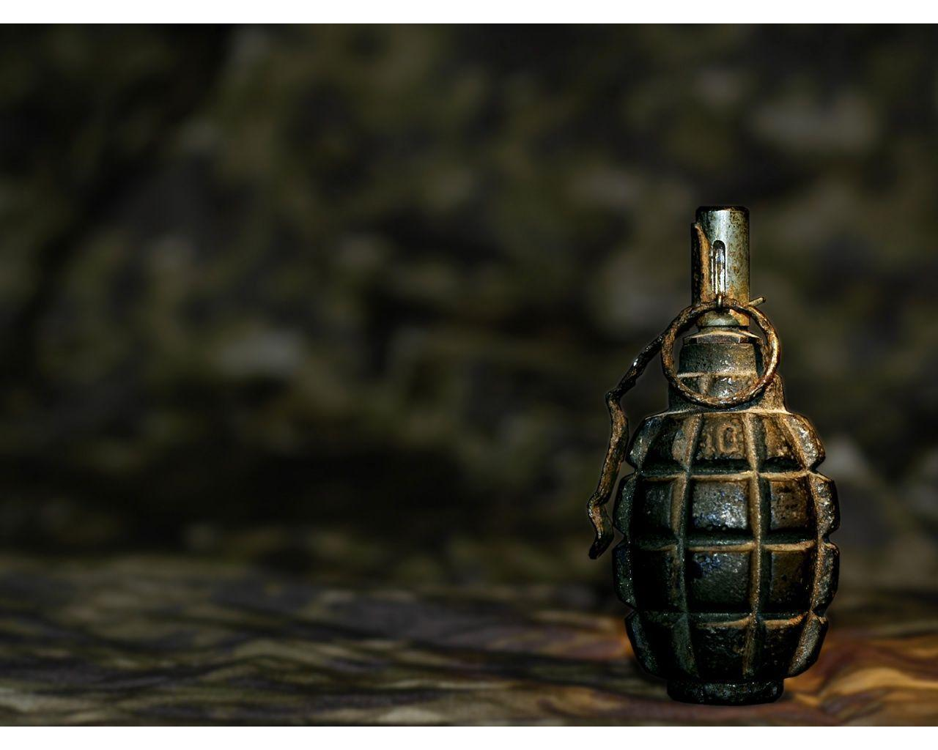
Special Features Of RACSHAK
Wireless Bot
Able to spy the location
Provided with suitable Arm circuitry
Live camera view to remote location
Gun firing ability
SONAR sensors
Bot location through GPS
All Terrain Vehicle

Slide 8
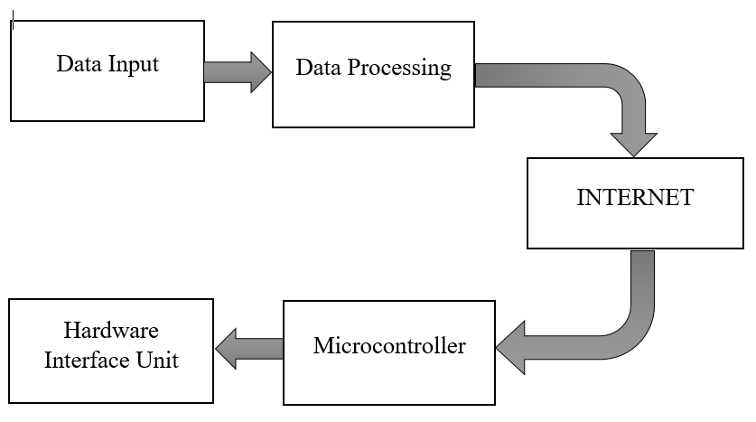
Methodology
General Block Diagram

Slide 9
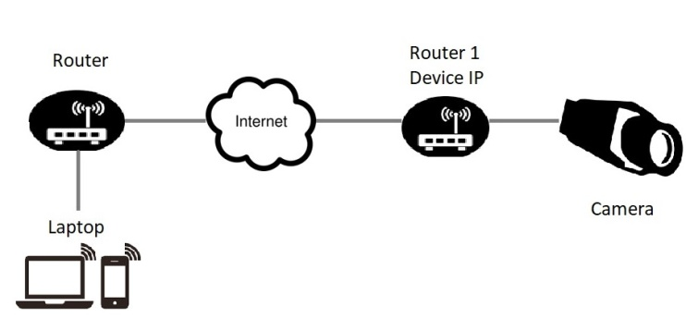
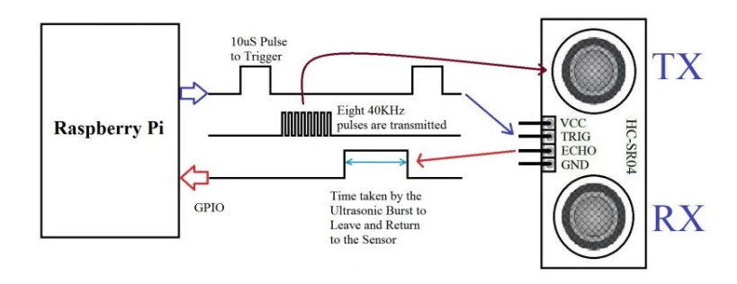
Camera Working Block Diagram
Ultrasonic Sensor Block Diagram

Slide 10
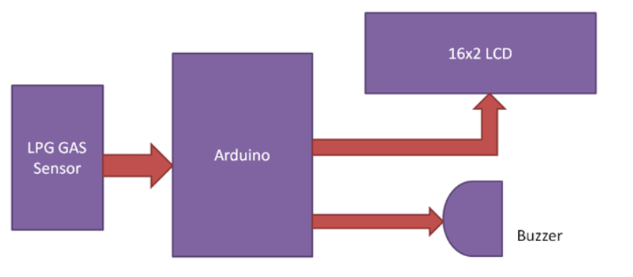
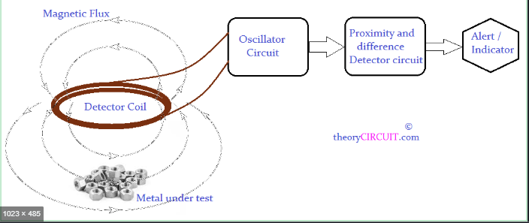
Gas Sensor Working Block Diagram
Metal Detector Working Block Diagram

Slide 11
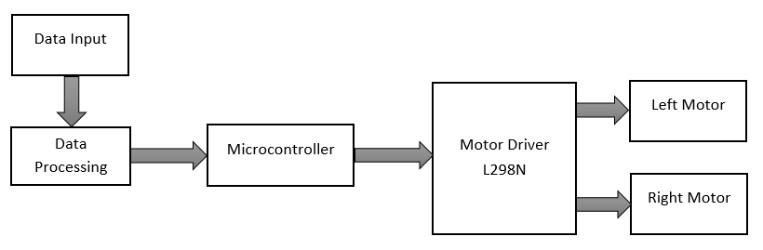
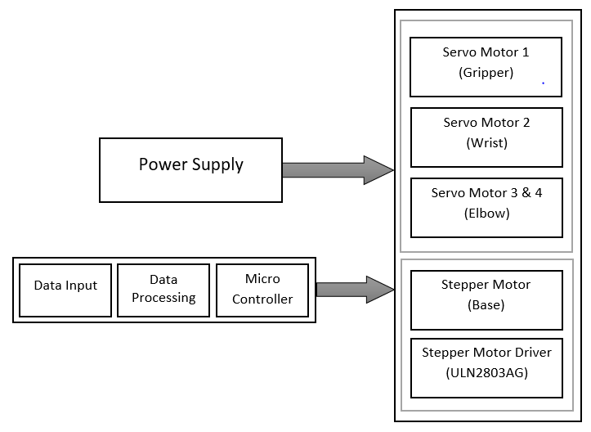
Bot Movement Block Diagram
ARM Working Block Diagram

Slide 12
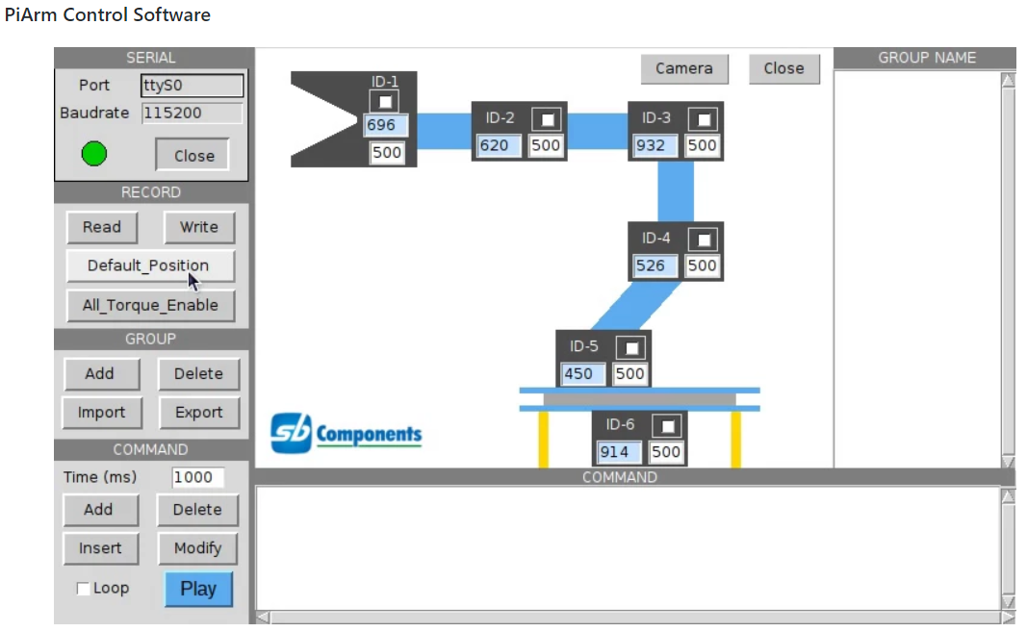
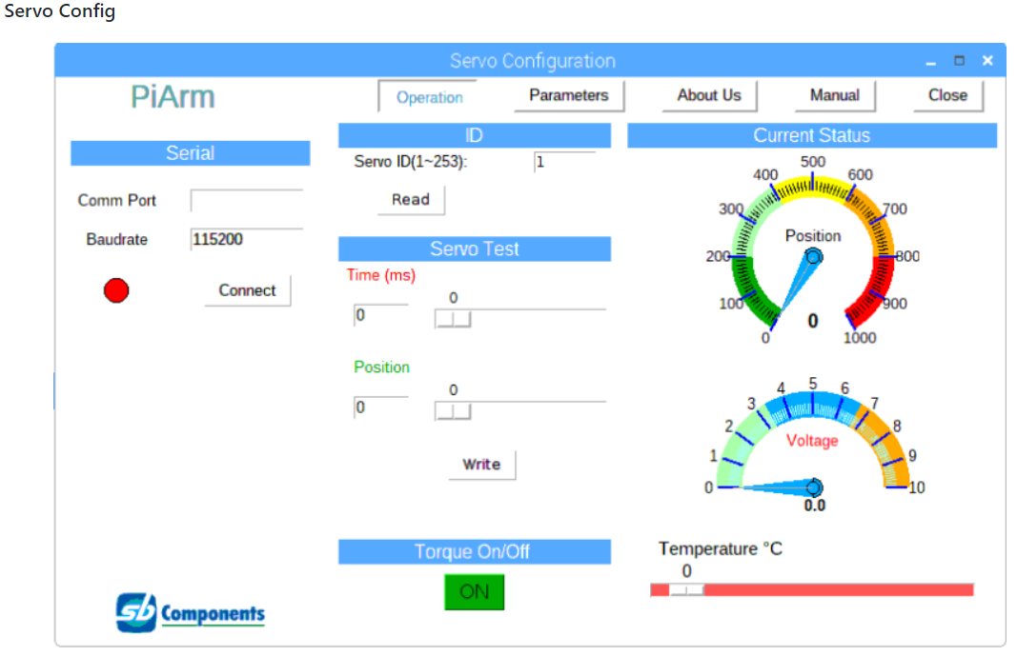
PiArm Control Software
Servo Configuration Software

Slide 13
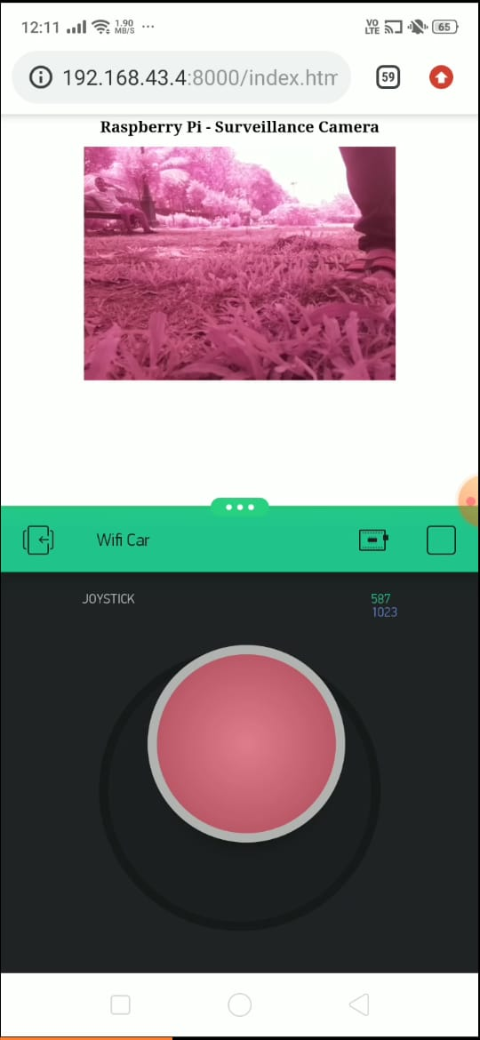
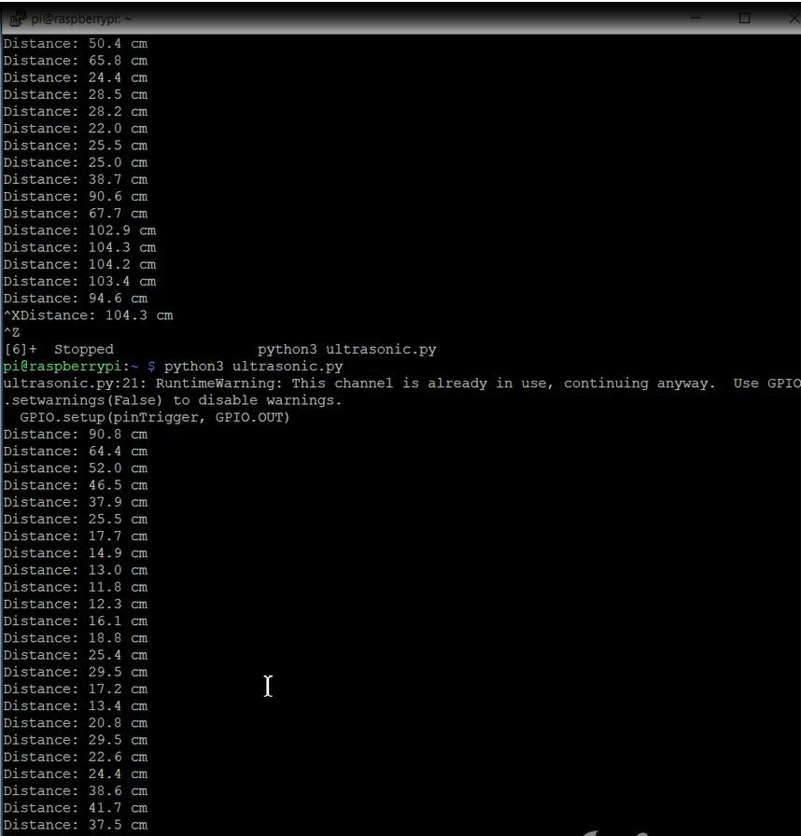
RESULTS
Fig. 1. Controlling interface using Blynk App and Pi Cam
Fig.2 Ultrasonic Sensors readings

Slide 14
DISADVANTAGES
Due to lack of high-power motors, speed of the bot is less.
Simultaneous working of Arm and Gun is not developed.
Less battery backup.

Slide 15
REFERENCES
Shital N Shinde, “Unmanned Ground Vehicle”, in International Journal of Advanced Engineering , Management and Science (Vol 2, Issue 10, Oct 2016).
Laura Barnes, MaryAnne Fields, Kimon Valavanis, “Unamnned Ground Vehicle Swarm Formation Control Using Potential Fields” in IEEE Mediterranean Conference on Control and Automation (June 29, 2007).
Shingo Shimoda, Yoji Kuroda , Karl Iagnemma, “Potential Field Navigation of High Speed Unmanned Ground Vehicles on Uneven Terrain” in IEEE International Conference on Robotics and Automation (April 2005) R. Nicole, “Title of paper with only first word capitalized,” J. Name Stand. Abbrev., in press.
United States Army Communications-Electronic Command Research, Development & Engineering Center Fort Belvoir, Virginia 22060-5806 (2002).
Talukder, et. al., "Autonomous terrain characterization and modeling for dynamic control of unmanned vehicles," International Conference on Intelligent Robots and Systems, 2002

